Slide 1
README
BURN AFTER READING
about_SlideDeck
The actual presentation starts with slide 6 ("Session title"). The first five slides have a purely organisational purpose. During the break before your session, you should start the presentation with slide 2 ("Next up"), so that the audience knows that they are in the right room. It's fine if you start chatting with the audience during this break, but we need a precise starting point for your presentation in terms of editing your video. That means:
The recording of your presentation will start after the countdown. Please (RE)START talking after the countdown, not during it! Otherwise your recording will start with a half sentence.
It is not necessary to explicitly signal to the PA operator, this is your signal!
Finally, do you have to use this slide deck? No, you are free to present the way you like it. But you are asked to use the intro slides: countdown, session title, sponsor slide. Beyond that, use what is good for the cause – from no slides to sketches from your children, from Jupyter to $youNameIt.
You will find additional information in the notes below.
Sincerely, your hosts!
Dear Speaker, we are thrilled and honored to have you with us in Malmö in 2025. Take your time and read this before you prepare your session.
Since most of you have been with us before, you will already know a lot about PSConfEU. You know that we try to capture all sessions carefully and publish your work on YouTube. There are a few easily avoidable stumbling blocks that we would like to draw your attention to:
Your screen resolution should be 1920x1080 px (FullHD)
You should provide a full size HDMI socket
Mirror your screen
Disable "Presenter View" in PowerPoint
Using MAC or Surface book? Be aware of HDCP!
Disable the ‘Night Light Mode’
Notes:
The fine print (additional information)
Why should you care about HDCP?
"High-bandwidth Digital Content Protection (HDCP) is a form of digital copy protection developed by Intel Corporation to prevent copying of digital audio and video content as it travels across connections. Types of connections include DisplayPort (DP), Digital Visual Interface (DVI), and High-Definition Multimedia Interface (HDMI), as well as less popular or now deprecated protocols like Gigabit Video Interface (GVIF) and Unified Display Interface (UDI)."
https://en.wikipedia.org/wiki/High-bandwidth_Digital_Content_Protection
Some notebooks ignore the HDCP standard, some vendors comply with the standard. Apple and Microsoft are somehow famous for strictly following the HDCP guidelines. Sadly, we will not be able to guarantee, that your session can be recorded in the latter case.
But you can do simple things, to overcome these problems. It is also very likely that you presented with your notebook before. So you will know, if this worked fine.If you are in doubt and if the agenda allows, try a dry-run a day before and connect everything.
In general you can easily bypass HDCP restrictions with a cheap splitter (the cheaper the better), just like the one you see below. This is an example device that we bought for 16 euros (in Germany).
Ask us, we will lend you such a device.
Thorsten also gave a whole presentation about "Broadcasting yourself" - easy steps to record yourself and create a (backup) session recording on your own. If you want to invest your time and dive deeper, take a look at his recordings and notes:
https://vimeo.com/thorstenbutz/byourself
This is of course completely voluntary, but perhaps you will find it helpful.

Slide 2
Building robust CI/CD pipelines with GitHub Apps and custom automation
Emanuel Palm

Slide 3
3
3

Slide 4
2

Slide 5
1

Slide 6
Building robust CI/CD pipelines with GitHub Apps and custom automation
Emanuel Palm

Slide 7


🔁
PSConfEU2025-Core
PSConfEU2025-Internal

Slide 8
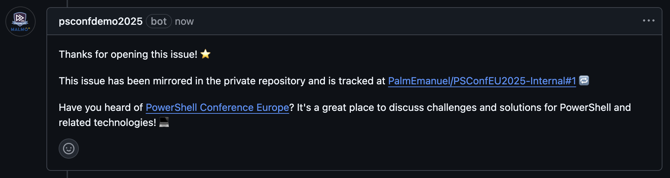

+1
PSConfEU2025-Core
PSConfEU2025-Internal

Slide 9
+1
+1
PSConfEU2025-Core
PSConfEU2025-Internal

Slide 10

+1
+1
PSConfEU2025-Core
PSConfEU2025-Internal

Slide 11
Mirror Issue to Internal Repo
+1
+1
PSConfEU2025-Core
PSConfEU2025-Internal
Post Comment on Original Issue

Slide 12

Many thanks to our sponsors:

Slide 13





Emanuel Palm
Cloud Specialist @ Unwonted
💙 Everything-as-Code
📦 Makes modules & tools
📃 Fan of Open Source
☁️ Blogs at pipe.how
☕️ Runs arkanum.coffee
🏃🧗🥏🍰🧙
https://www.powershellgallery.com/packages/Bicep https://www.powershellgallery.com/packages/AzAuth https://www.powershellgallery.com/packages/AzBobbyTables

Slide 14
Agenda
GitHub Actions & Workflows
GitHub Apps
Tokens
Tips & Tooling
Demos!
Break
More demos!
Not covering all the basics, feel free to ask questions!

Slide 15
GitHub Actions Definitions
GitHub Actions (the CI/CD platform, or “product”)
Workflows (has triggers, jobs and steps)
Actions (can be one or multiple steps)

Slide 16
Types of GitHub Actions
Public Actions on Marketplace
actions/upload-artifact@v4
Custom Actions
Docker Container
JavaScript Actions
Composite Actions

Slide 17
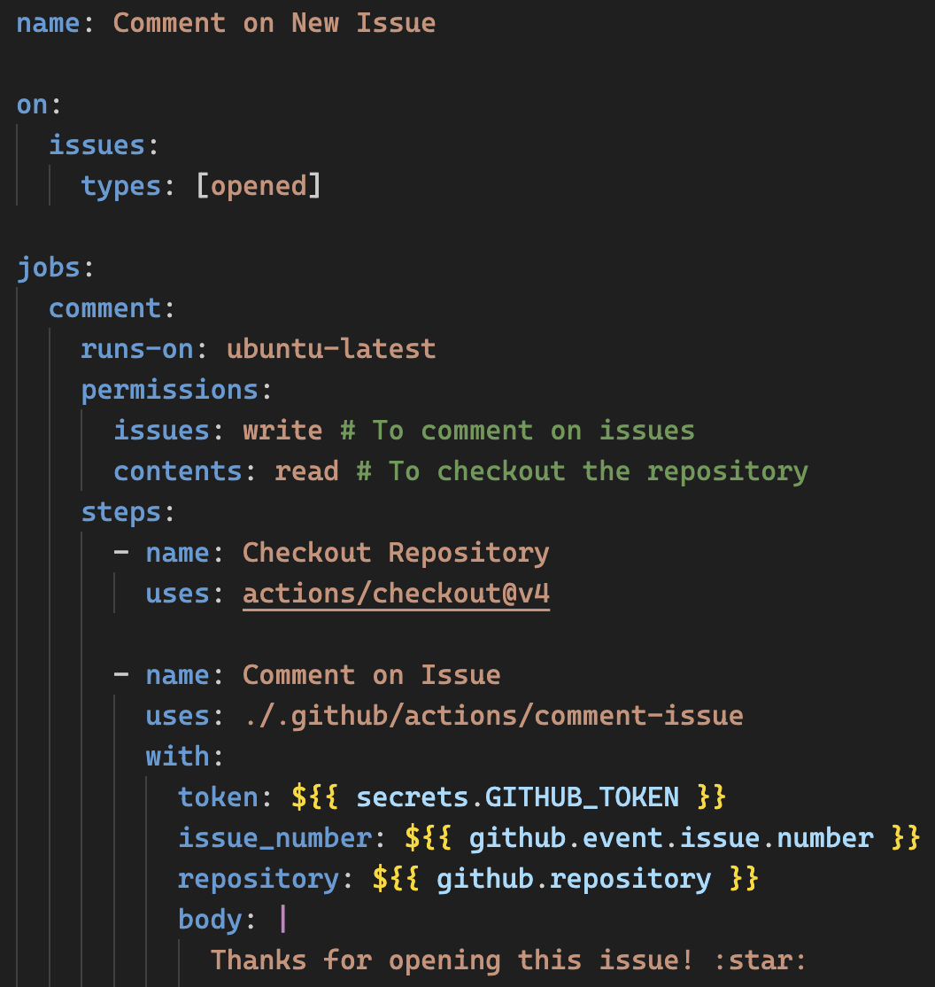
Example of a GitHub Workflow

Slide 21
Workflow Context Variables
Branch
Conditional logic for PRs
Triggers
How did this start?
Events
Which issue was created?
Secrets
Not accessible from forks

Slide 22
Thoughts on Secrets
Internal Collaborators & External Collaborators
Need access to repo secrets in PRs?
You don’t, never give anyone access to secrets from PRs
Limitations on passing secrets between jobs

Slide 23

Tips & Tooling
Workflows can be Status Checks for PRs
Steps, Environment Variables and Outputs
Tooling
VS Code + Github Actions Extension
Default Branch (“main”)
Workflow Triggers
Environments
Approvals
Conditional Secrets & Variables
Matrix & Strategy
Fantastic for cross-platform module testing

Slide 24
GitHub Apps
Extend GitHub functionality
Work with Events & Webhooks
Today we’re not using webhooks
There are also older “OAuth Apps”
Store Secrets & Private Keys securely

Slide 25
GitHub Apps vs OAuth Apps?
OAuth Apps support on-behalf-of workflows (logging in as a user)
GitHub Apps support both on-behalf-of and independent actions
Today we’re focusing on independent actions
But you can do stuff like ”Login with GitHub”
Enhanced security
Fine-grained permissions
Access delegated per repository
Short-lived tokens
GitHub App installations are not tied to a user
Improves offboarding, no relying on single accounts
Removes need for Personal Access Tokens

Slide 26
Token Types (don’t we love it)
GitHub Personal Access Token (PAT)
GitHub Fine-Grained PAT
GitHub App JWT (JSON Web Token)
Only for authenticating, used for requesting installation tokens
GitHub Installation Token
GitHub Actions Workflow Token (GITHUB_TOKEN)
Actually an automatic Installation Token for the GitHub Actions App
ID Token (GITHUB_TOKEN)
For OIDC and Workload Identity Federation
User Access Token
Preferably through GitHub Apps instead of OAuth Apps

Slide 27
What are we creating today?
Demo 1 – Comment on new issues in same repo
Demo 2 – Comment as custom app identity
Demo 3 – Mirror issues to another repo and comment

Slide 28
Demo
Notes:
Demo 1
Go through scaffolded Workflow
Show intellisense and tooling
Finish scaffolded action file with step
Finish scaffolded PowerShell script
Create issue and show comment

Slide 29
Break time!

Slide 30
Demo
Notes:
Demo 2
Create a GitHub App, show permissions
Install App on repos
Create Private Key and add to demo.ps1 file
Run local code to show installations of pre-created application
Create action for getting installation token
Change workflow from part 1 to use action with installation token and posting comment instead
Create issue and show comment
Demo 3
Install app on second repository
Change workflow in public repo
Change comment to instead post repository_dispatch to private
New workflow in private repo
Triggers on repository_dispatch on a type called mirror
Creates an issue with a link to the issue in the payload
Posts comment back to the public repo with type mirror
Make repos public for future

Slide 31



Summary
GitHub Apps allow us to extend GitHub
Cross-repository permissions
We explored issue creation & comments
But any event is possible with webhooks
Opens the door to any automation
Improve organization & developer productivity

Slide 32
Questions & Potential Answers

